Slide 1

Electrical and Computer Engineering Department
University of Victoria
Proximity Effect in EBL
by:
Zeinab Mohammadi
November 2011

Slide 2
Outline
Definition
Origins
Avoidance of Proximity
Correction

Slide 3
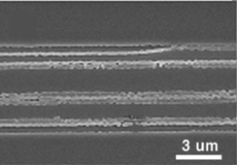
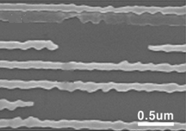
Definition
The proximity effect is the change in feature size of pattern as a consequence of nonuniform exposure!
Pattern affected by proximity (left), After elimination of proximity effect (Right)

Slide 4
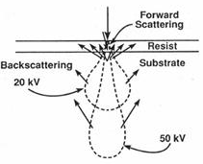
Electron-Solid Interactions
Forward Scattering Backward Scattering
Secondary Electrons
Notes:
In order to know what exactly happen, it is worthwhile to look at to electron beam interactions.

Slide 5
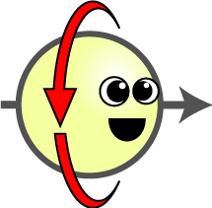
Forward Scattering
As the electrons penetrate the resist, they experience many small angle scattering events, which tend to broaden the initial beam diameter.

Slide 6

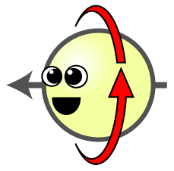

Backward Scattering
As the electrons penetrate through the resist into the substrate, they occasionally undergo large angle scattering events

Slide 7
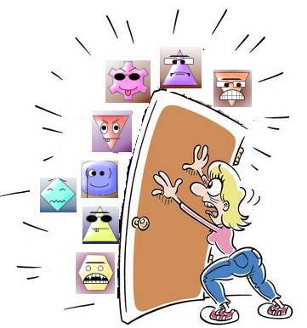
Secondary Electrons
As the primary electrons slow down, much of their energy is dissipated in the form of secondary electrons with energies from 2 to 50 eV and this energy accumulates around patterned areas!
Low energy!
High energy!

Slide 8
Proximity Effect Avoidance
Adjust the pattern size
Exposure of low energy e-beam
Multilayer resists coating techniques

Slide 9


Correction
Dose Modulation
Background Exposure Correction (GHOST)
Software
Very common technique with good resolution
Time consuming
No computation required
Extra data preparation and writing time, less resolution

Slide 10
Conclusion
Proximity effect concepts reviewed
Reason why it happens discussed
Techniques to avoid and correct it considered

Slide 11

Any Questions?!

